Slide 1
NEURAL NETWORKS AND DEEP LEARNING
15CSE380
NISHANTH S U4CSE17149
PVS SRI ALAVANDAR U4CSE17150
P VAMSI KRISHNA U4CSE17152

Slide 2
FINAL PROJECT
BRAIN TUMOR CLASSIFICATION
GROUP - 5

Slide 3
Executive Summary:
This project is done as a solution to the dataset which is provided by Kaggle. This project is an image classification problem using deep Convolutional Neural Networks to classify whether the image of a brain MRI has a tumor or not. Better performance of this model would help the medical professionals to detect tumors in MRI scans where the number of images is very high and manual processing is time taking.

Slide 4
Problem Description
The problem is to classify an MRI scan image of a brain, based upon whether it has a tumor or not. There are two classes in which the images have been classified i.e, ‘yes’ and ‘no’, we need to build a deep learning model such that, given a new image of brain MRI, the model should be able to classify it to a class ‘yes’ or ‘no’ with reasonably high accuracy measures.

Slide 5
Dataset
The dataset was available in Kaggle in the datasets section. There are 253 images in total, out of which 168 images were in the ‘yes’ class, and the rest were classified as ‘no’. The dataset is 15 MB in size and the images were of jpg and jpeg formats.
Here is a link to it https://www.kaggle.com/navoneel/brain-mri-images-for-brain-tumor-detection

Slide 6
Approach
A VGG model is one of the most powerful and complex Convolutional Neural Network(CNN) which can give highly accurate results in image classification.
We used a concept called transfer learning, through which we can use a pre-trained model(which was previously trained on another dataset) and can add more layers to it, and then fit the model training data. But before we can do this we need a properly preprocessed dataset to work with.
Steps taken in the preprocessing step are :
Create three directories named ‘TRAIN’, ‘VAL’, ‘TEST’ in order to partition the dataset.
Split the dataset 80% of the data for training(‘TRAIN’), 5 data points for testing(‘TEST’), and the remaining for validation (‘VAL’).

Slide 7
Models Used
Other than using the traditional VGG-19 to solve the problem we have also considered alternatives for the existing approach and chose the model with the best test accuracy.
Models Used :
VGG-19
VGG-16
RESNET50

Slide 8
Developing a VGG-19 Model
We import that base model of VGG-19 and input images that are resized to (227,227), but before inputting, we added fully connected layers and the output layer is of size two for classification

Slide 9
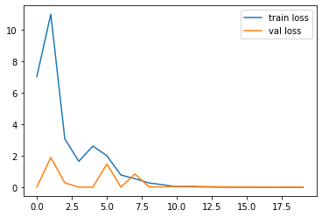
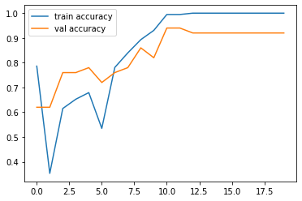
The accuracy obtained for VGG -19 model after testing the TEST data set is 81.2%

Slide 10
Developing a VGG-16 Model
VGG-16 is the previous version of the VGG-19 model.
It is also as powerful and accurate as VGG-19.
The preprocessing and data augmentation were done using vgg16 preprocess function and the model was fit to the training data.

Slide 11
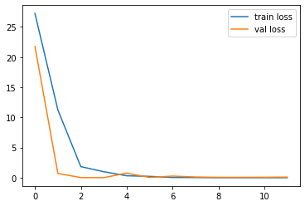
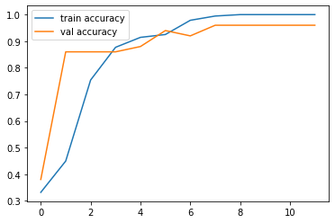
The accuracy obtained for VGG -16 model after testing the TEST data set is 93%

Slide 12
Developing a RESNET 50 Model
Resnets are one another such CNN which gives good results with image classification.
The preprocessing and data augmentation were done using Resnet50 preprocess function and the model was fit to the training data

Slide 13
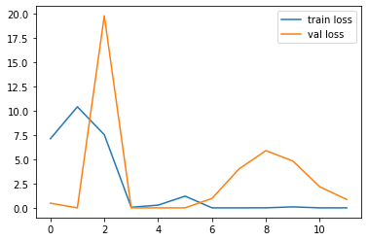
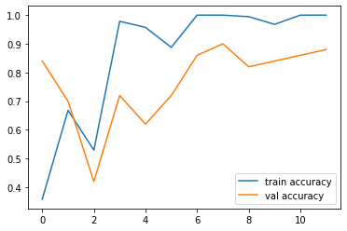
The accuracy obtained for RESNET 50 model after testing the TEST data set is 75%

Slide 14
KEY FINDINGS
The VGG-16 model has the best accuracy value for the test dataset which around 93%.
Followed by VGG-19 which gave an accuracy of 81% Followed by RESNET50 which gave an accuracy 75% i.e, given a new image the VGG-19, VGG-16 models are more likely to classify it correctly.

Slide 15
This project was a combination of the CNN model classification problem (to predict whether the image has a brain tumor or not) & Computer Vision problem (image processing and image augmentation).
The final accuracy is much higher than the 50% baseline. However, it could be increased by a larger number of train images or through model hyperparameters tuning.
CONCLUSION

